Slide 1
Classification of SD-OCT Volumes using Local Binary Patterns
Advanced Image Processing Project
M.Tech : Sem-II
Parth Shah(16IS15F)
Tejeshwara(16CS23F)
Bhaskar Gautam(16CS04F)

Slide 2
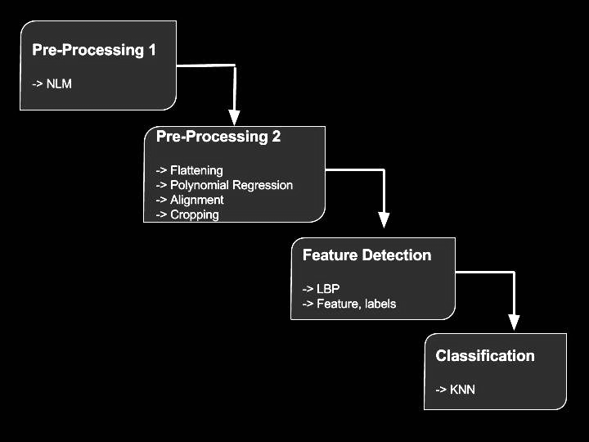
Overview:

Slide 3
Pre-Processing
This part consists of two things:
Non Local Means - For denoising of image.
Flattening - For straightening of retinal surface.
Aligning - For cropping required region.

Slide 4
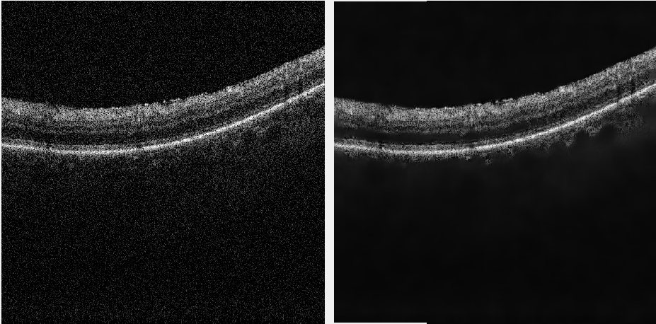
Non Local Means
Noisy Image
Denoised Image

Slide 5
Flattening and Aligning
It consists of following steps:
First, do Image Binarization using Otsu’s Method.
Then, do Morphological Close operation to fill holes.
Then find central line of the retinal surface which may not be smooth.
Do Polynomial Regression to smoothen the central line.
With respect to this central line, change position of pixels in each columns to straighten the curve/retinal surface.
Crop that region from whole image.

Slide 6
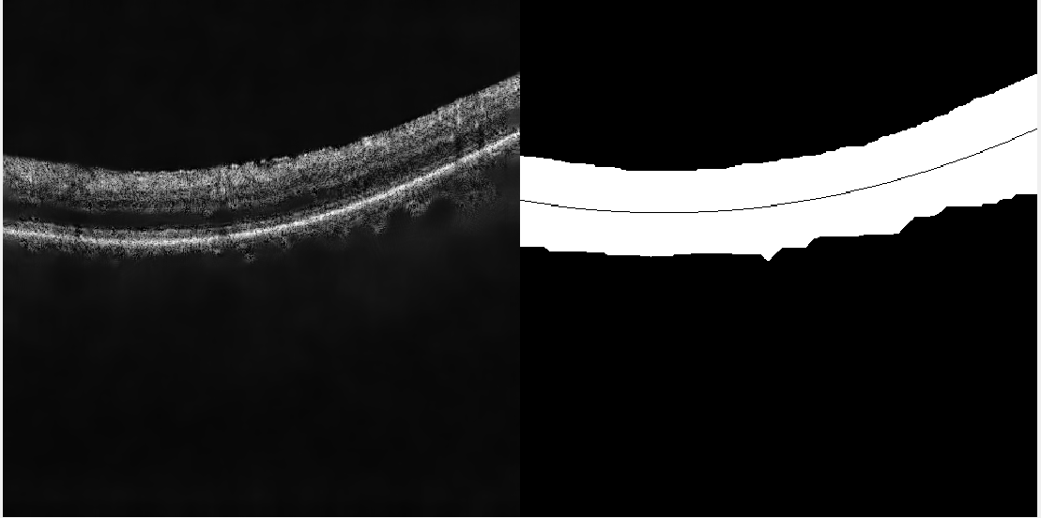
Otsu’s Binarization and Central line Finding:

Slide 7
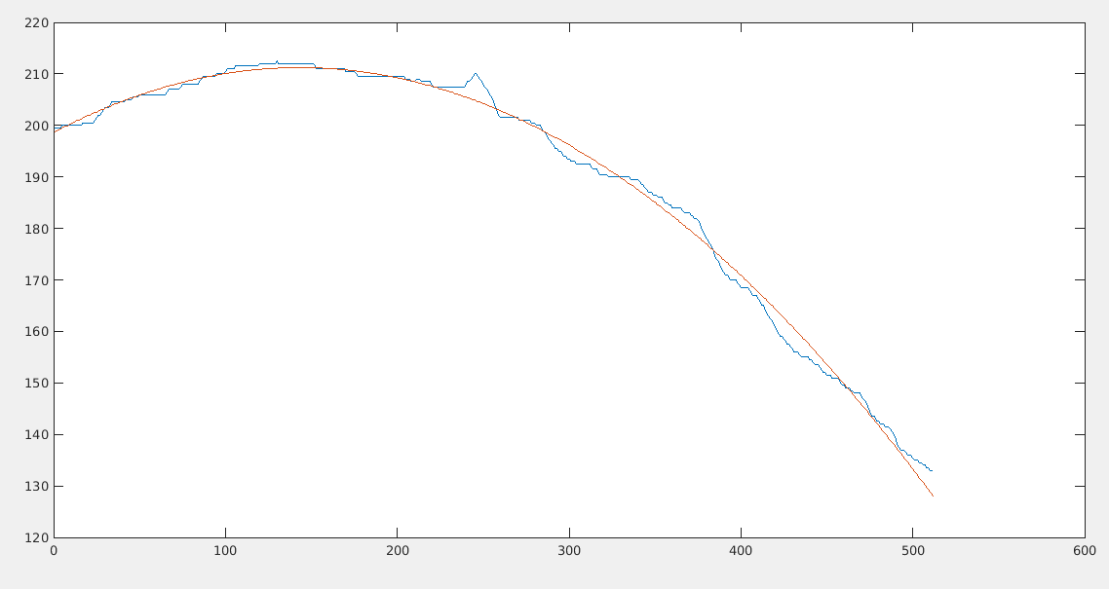
Polynomial Regression:

Slide 8
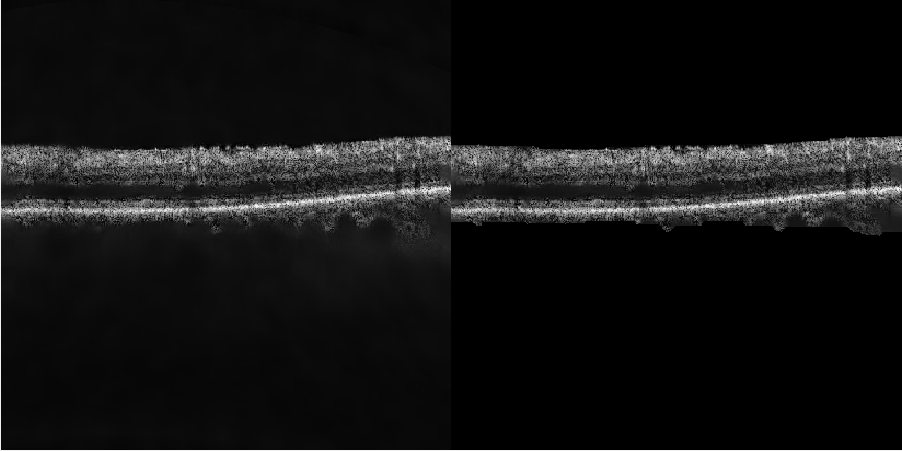
Flattening and Aligning curve:

Slide 9
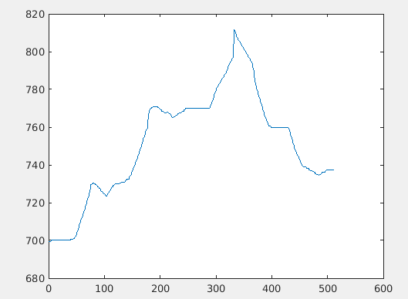
Without Polynomial Regression

Slide 10
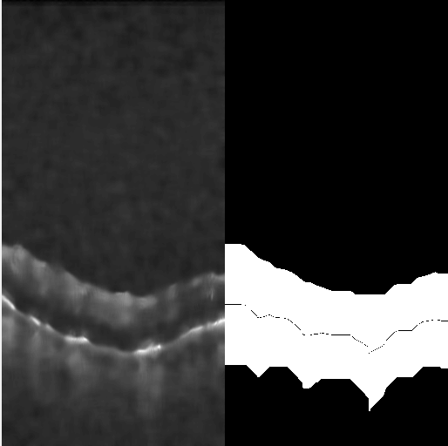
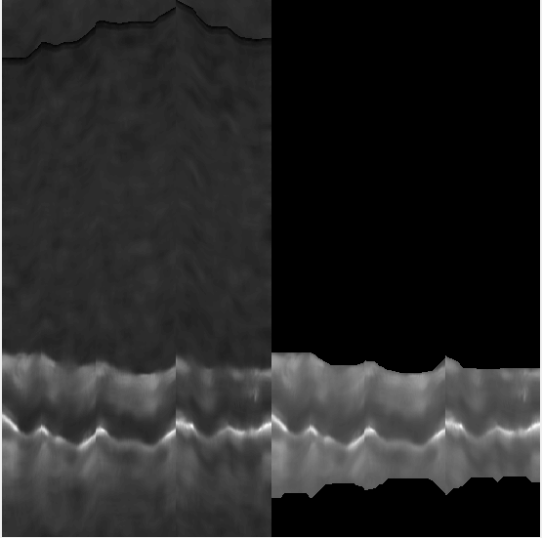
Gives Distorted Flattening

Slide 11
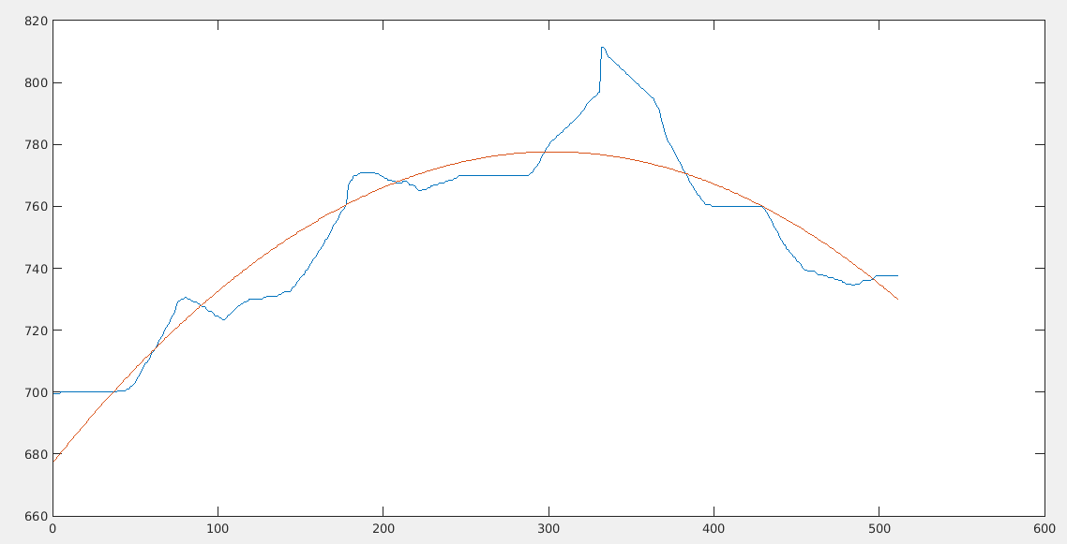
With P.R.

Slide 12

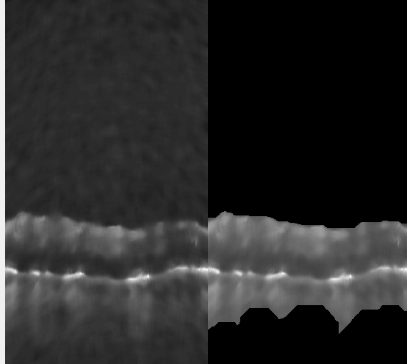
Gives smooth Curve

Slide 13
Local Binary Pattern
LBP is used for Texture Recognition where features are not specifically defined and texture is the only feature of the object.
In LBP, a windwos of (P,R) is taken where P is number of boundary pixels and R is radius.
The central pixel is compared with boundary pixel and assigned value 1 if greater than central pixel otherwise 0.
On taking sequence of all these pixels gives decimal number in range [0,255]. Thus whole image will contain such pixel values and Histogram of that image is taken as feature vector and fed to any classifier.

Slide 14
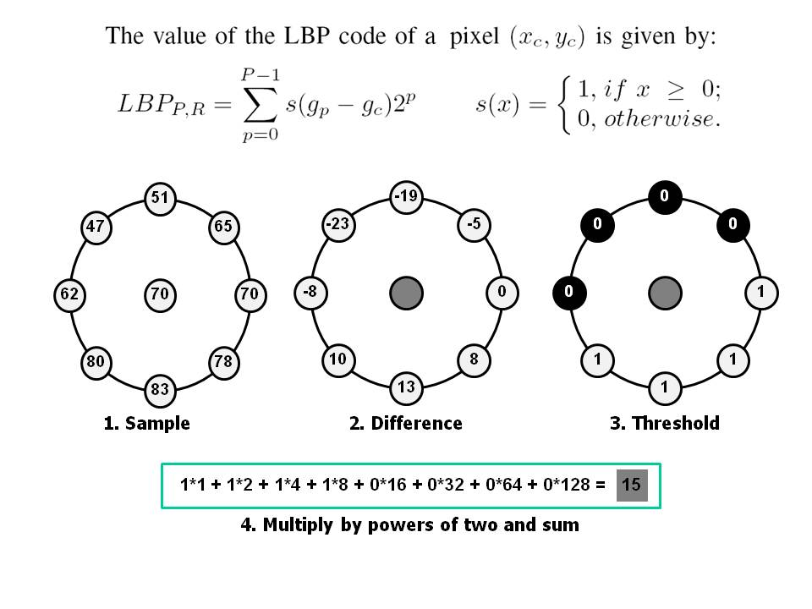

Slide 15
Uniform LBP
Here instead of giving values in range [0,255], lables are given based on patterns.
Uniform Pattern: A sequence is called uniform pattern if there are at most two transitions from 1 to 0 and/or vice-versa when sequence is considered circular chain.
Each uniform pattern are given unique labels and single label to nonuniform one.
E.g. For sequence-> 00011000 is uniform and 10000000 is also uniform
But 1000100 is not uniform.
Thus there can be atmost 59 labels.

Slide 16
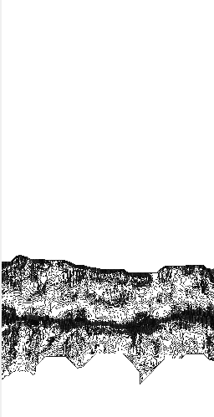
LBP of previous Images:

Slide 17
Classification
Here we have used K-nearest neighbour classifier which will take Histogram of images obtained by using LBP and will map to Labels which will indicate if a particular frame in DCM Volume contains DME/cysts or not.
Model is trained with data of 31 patient and already known data of 32 patient is taken here as test case for this model
Accuracy of this model: 80%
Specificity: 100%

Slide 18
Thank you

